Slide 1
Email Artifacts

Slide 2









Objective
By the end of this module, participants will be able to search emails using industry-standard tools for forensic investigations

Slide 3
Introduction to Email
Internet-based applications have changed how people communicate
Traditional communication methods have been enhanced
Contact anyone at anytime, anywhere in the world – in real time
Instant sharing of files

Slide 4


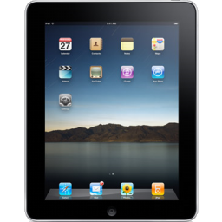


What Is Email?
Internet-based application enabling users to send and receive messages with guaranteed delivery
Messages can be accessed from many devices
Cell phones
Tablets
Computer systems

Slide 5
Client-Based Versus Web-Based Email
Client-Based | Web-Based
Installed by the Operating System Configured according to the user’s preferences and server settings | Are typically accessed via an Internet browser Store user content on a remote server

Slide 6


How Does Email Work?
Messages are sent and received over the Internet to an email address using specific network protocols
Delivery to recipient is guaranteed

Slide 7
Host and Domain
Host:
A member given access to use network resources
mmouse@gmail.com
Domain:
Collection of shared network resources

Slide 8
Internet Protocols
Simple Mail Transfer Protocol (SMTP)
Post Office Protocol (POP)
Internet Message Access Protocol (IMAP)
Hyper Text Transfer Protocol (HTTP)

Slide 9
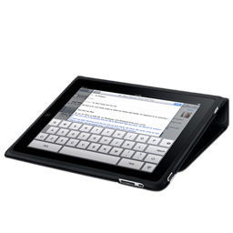






Email Delivery
From: mmouse@gmail.com
To: dduck@yahoo.com
mmouse@gmail.com
Where is dduck’s mailbox?
MDA
Yahoo.com MX
106.10.170.118
MUA
Internet
MUA
MSA
MTA
What is yahoo.com’s MX record?
dduck@yahoo.com
DNS
mx.yahoo.com (106.10.170.118)
Notes:
MSA
Mail Submission Agent
MTA
Mail Transfer Agent
MUA
Mail User Agent
MX
Mail Exchanger
SMTP
Simple Mail Transfer Protocol
POP
Post Office Protocol

Slide 10



Client-Based Email Applications
Installed on Internet-capable devices
Microsoft Outlook
Mozilla Thunderbird
Apple Mail (Macintosh OS X)
User email data stored and managed in locally accessible databases
Contacts
Inbox
Sent Items

Slide 11




Locating Email Artifacts: MS Outlook
Proprietary database format → Personal Storage Table (*.pst extension)
Contacts
Messages
Calendar
MS Outlook 2010 database default location → C:\Users\<username>\Documents\Outlook Files

Slide 12
Locating Email Artifacts: Thunderbird
User data stored in open database format → MBOX
Email messages stored in plaintext in one file
Inbox
Sent Mail
Mozilla Thunderbird database default location → C:\Users\<username>\AppData\Roaming\Thunderbird\Profiles\*.default\

Slide 13



Web-Based Email Applications
Email content is accessed via an installed Internet browser on device → Webmail
Google Mail (Gmail)
Windows Live Mail (Hotmail)
Yahoo! Mail
User data is maintained at the server level
Inbox/Sent Items
Contacts
Trash

Slide 14
Locating Email Artifacts: Webmail
Some artifacts can be recovered
Temporary Internet Files
Pagefile.sys / Hiberfil.sys
NTFS metadata ($MFT, $LOGFILE)
Registry

Slide 15
Email Message Headers
Detail journey of message from sender to recipient
Could provide clues on network identity of sender
Google Mail (when accessed via the browser) hides senders’ network identity
Stored as header of original email message
Typically manually accessed by user/analyst
Hidden by most email clients

Slide 16
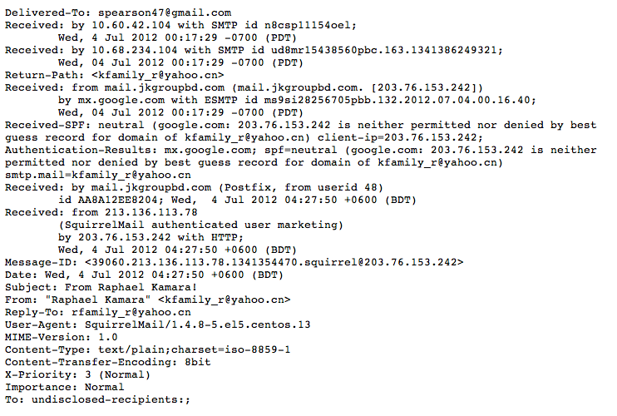
Analyzing Email Message Header
Recipient’s email address
Received tags show
each hop
Could be sender’s actual IP address
→ *traceable to ISP

Slide 17



Summary
You should now be able to
Access different types of mail files
Sort mail using defined fields
Filter mail types by keyword
Analyze an email header

Slide 18
Thanks!
Any questions?

